Slide 1
Project Sundial
Final Project
CSE 4202

Slide 2
Team Members
Mahajabin Tabassum
ID: 200041132 Group: 1B
Jarin Tasnim Hridy
ID: 200041108 Group: 1B
Amina
ID: 200041155 Group: 1A

Slide 3
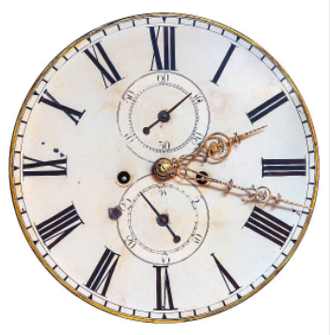
Project Sundial
The project is a clock enabling one to utilize time by using the basic features that one would find on a standard digital clock with a unique feature of Voice Generator.
C programming language is used to design the project.

Slide 4
Project Sundial

